Slide 1
Patterns of Interaction 2: Publish-Subscribe
CS 5010 Program Design Paradigms
"Bootcamp"
Lesson 11.6
© Mitchell Wand, 2012-2014
This work is licensed under a Creative Commons Attribution-NonCommercial 4.0 International License.

Slide 2
Key Points for Lesson 11.6
Publish-Subscribe is a programming pattern for implementing push-style communication between objects over time.
In pub-sub, a publisher keeps a list of subscribers.
When the publisher changes state, it sends a message notifying each of its subscribers about the state change.
Each subscriber changes its local state to take note of the messages it receives from the publisher.
Now, the subscriber can consult its local state instead of sending queries to the publisher.
Good if queries are much more frequent than state changes.

Slide 3
How to organize collaborating objects?
First rule of good OO Design!
Principle of Least Knowledge:
Reveal only what's necessary.
Problem: how does the information get to where it's needed?
We've already talked about this a little in Lesson 11.1
What happens in a stateful system?

Slide 4
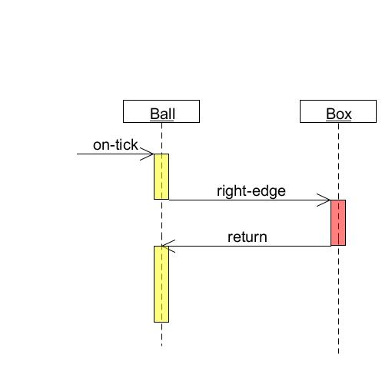
How does a ball decide when to bounce in ball-factory.rkt?
In ball-factory.rkt, every time the ball receives an on-tick message, it asks its box for the location of its right edge. This is a pull model.
Diagrams like this are called sequence diagrams in UML.
Ball pulls info from the box

Slide 5
Can we do better?
The ball asks the box about its edge at every tick.
But this information doesn't change very often.
Better idea: Have the box send a "changed-edge" message to the balls only when the edge actually changes.

Slide 6
This is a push model
When information changes, the person who changes it pushes it out to the people who need to know.
How does the information-changer know who to tell?
The information-needer must register with the information-changer.

Slide 7
Push model, con'td
So each ball must tell the box that it needs to hear about changes in the edge position.
This means that the balls will now need to be stateful, too, so the box can find them.
This pattern is called publish/subscribe
also called the observer pattern.

Slide 8
Video Demonstration: publish-subscribe.rkt
http://www.youtube.com/watch?v=EsAO0QjCZbA

Slide 9
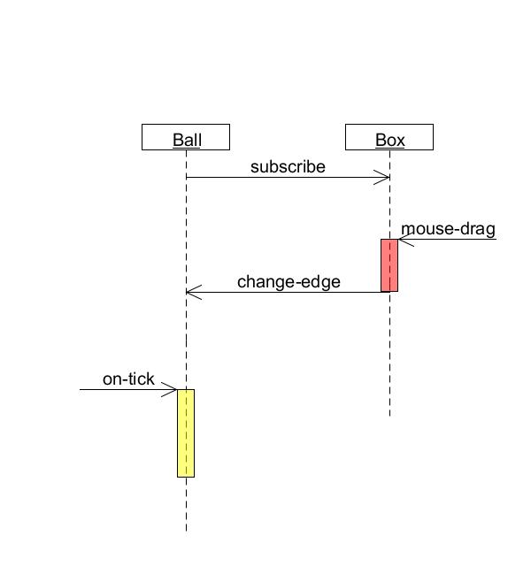
How does a ball decide when to bounce in publish-subscribe.rkt?
Here’s a similar diagram showing what happens in publish-subscribe.rkt
1. When the ball is created, it subscribes to notifications from the box.
3. When the ball receives this message, it updates its local right-edge field.
2. When the box receives a mouse drag, it sends out a message to all its subscribers notifying them of the new location of the edge.
4. When the ball receives an on-tick message, it consults its local right-edge field to determine the current location of the right edge.
This is a push model: the box pushes information to the ball for the ball’s later use.
Box pushes information to the ball

Slide 10
Extending pub-sub
What if we wanted to deal with multiple messages?
Say we wanted to move both left-edge and right-edge.
Here are several possible designs:

Slide 11
Design #1: Separate subscription lists
Each kind of message would have its own subscription list and its own method name
e.g., change-left-edge, change-right-edge
Each class signs up for just the messages it wants to see.
Will need separate interfaces for each kind of message, e.g., left-edge-publisher<%>, left-edge-subscriber<%>
Good choice if different groups of methods want to see different sets of messages.

Slide 12
Design #2: Single subscription list, multiple methods
Better if most classes want to see most of the same messages.
Have a different method name for each kind of message, eg change-left-edge, change-right-edge (same as design #1)
All subscribers now see all the messages, so they need to supply methods for all the messages.
The method can simply ignore the messages it’s not interested in.
Single interface subscriber<%>.
This is just what we did in World%, with on-tick, on-mouse, etc.

Slide 13
Design #3: Single subscription list, single method
Like #2, but use the message body to represent which message it is.
Can do this in different ways, too:

Slide 14
Represent messages in arguments
;; A Direction is one of:
;; -- "left"
;; -- "right"
;; Code in receiver:
;; change-edge : Direction NonNegInteger -> Void
;; EFFECT: sets the edge in the given direction to
;; the given value
;; STRATEGY: Struct Decomp on Direction
(define/public (change-edge dir val)
(cond
[(string=? dir "left") (set! left-edge val)]
[(string=? dir "right") (set! right-edge val)]))

Slide 15
Introduce data type of messages
(define-struct change-left-message (val))
(define-struct change-right-message (val))
;; A ChangeEdgeMessage is one of
;; -- (make-change-left-message NonNegInteger)
;; -- (make-change-right-message NonNegInteger)
;; change-edge : ChangeEdgeMessage -> Void
;; EFFECT: sets the edge in the given direction to the given value
;; STRATEGY: Struct Decomp on Direction
(define/public (change-edge msg)
(cond
[(change-left-message? msg)
(set! left-edge (change-left-message-val msg))]
[(change-right-message? msg)
(set! right-edge (change-right-message-val msg))]

Slide 16
The agreement between publisher and subcriber
The publisher and subscriber must agree on a protocol for exchanging messages.
The protocol consists of:
A method for an object to subscribe to the messages
A set of subscriber-side methods that the publisher can call to deliver the messages
An agreement on what messages mean and how they are represented.
Information and its Representation as Data (again!!)

Slide 17
A Shortcoming of publish-subscribe
All of these designs use at least one of the subscriber’s method names.
What if some other object wanted to subscribe to notifications from the box, but for some reason it still needed to use the name edge-changed for something else?
Our current design ties up a method name (in this case edge-changed).

Slide 18
Doing pub-sub without relying on a common method name
Better solution: instead of registering an object, register a function to be called.
f : X -> Void where X is the kind of value being published
To publish a value, call each of the registered functions
It's a callback!
These functions are called delegates or closures.

Slide 19
Video Demonstration: delegates.rkt
http://www.youtube.com/watch?v=01ZbNpkGbho

Slide 20
box1
ball1
Publishing through a delegate
(subscribe f1)
subscribers =
(list f1)
on-mouse
f1
right-edge = 250
(publish 250)
(f1 250)
(lambda (n) (set! n))
ball1
box = box1
x = 100
y = 50
right-edge = ...
250

Slide 21
Whose right-edge ?
When we write
(lambda (n) (set! right-edge n))
we are referring to the right-edge field in this object.
The next slide shows a similar diagram illustrating what happens when there are two balls in the world.
Each ball has its own delegate, which refers to its own right-edge field.

Slide 22
f1
250
box1
ball1
ball2
(lambda (n) (set! n))
ball1
(subscribe f1)
box = box1
x = 100
y = 50
right-edge = ...
(subscribe f2)
250
subscribers =
(list f2 f1)
on-mouse
f2
250
right-edge = 250
(publish 250)
(f2 250)
(f1 250)
(lambda (n) (set! n))
ball2
box = box1
x = 120
y = 75
right-edge = ...
250
250
250
Many balls, many delegates

Slide 23
Reasons to use publish-subscribe
Metaphor:
"you" are an information-supplier
You have many people that depend on your information
Your information changes rarely, so most of your dependents' questions are redundant
You don't know who needs your information

Slide 24
Other uses of publish-subscribe
Use whenever you need to disseminate information to people you don't know.
They sign up once, and then you promise to update them when something happens to you (eg your information changes)
Both you and your subscribers must be stateful.

Slide 25
Example: multiple viewers
Imagine: some temperature is being monitored/modelled/controlled
Multiple viewers:
display in Celsius
display in Fahrenheit
display on a slider
May want to change/add viewers dynamically

Slide 26
Summary
Objects may need to know each other's identity:
either to pull information from that object
or to push information to that object
Publish-subscribe enables you to send information to objects you don't know about
objects register with you ("subscribe")
you send them messages ("publish") when your information changes
must agree on protocol for transmission
eg: (method-name <data>)
eg: call a registered closure with some data
it's up to receiver to decide what to do with the data.

Slide 27
Next Steps
Study the relevant files in the Examples folder:
publish-subscribe.rkt,
pub-sub-multiple-messages.rkt, and
delegates.rkt
If you have questions about this lesson, ask them on the Discussion Board
Do Problem Set #10.

